Slide 1
OCEAN IN TIMEs OF INTENSE CHANGE
罗佩珊
浙江大学 海洋学院
2026年4月30日

Slide 2
Previous name:
MARINE ENVIRONMENT AND GLOBAL CLIMATE CHANGE
海洋环境与气候变化

Slide 3
history
2014: Marine Chemistry and Global Climate Change – started by Prof. Chen Chen-Tung Arthur
2015-2017: Marine Chemistry and Global Climate Change – Dr. Loh Pei Sun
2018-2020: Marine Environment and Global Climate Change (combination with climate change on policy and economical aspects) – Dr. Loh Pei Sun and Dr. Ye Guanqiong
2021 to date: Ocean in Times of Intense Change – Dr. Loh Pei Sun
2024: Dr Loh Pei Sun and Prof Xiao Xi
2025: Dr Loh Pei Sun and Prof Chen Xue-Gang

Slide 4
The objectives
To improve understanding on the impacts of climate change (and human activities) on the dynamics of the marine environments

Slide 5
Course outline
Week | Subject | Summary
1 | Introduction | Climate change - causes and consequences
2 | Climate indicators | Ocean: impacts of climate change on ocean
3 | Hydrological cycle | Introduction; impacts of climate change and human activities
4 | Carbon cycle | Carbon cycle; impacts of climate change and human activities
5 | Carbon cycle | Solubility pump and Carbonate cycle; impacts of climate change and human activities
6 | Wetlands | Introduction; impacts of climate change and human activities
7 | Student presentation | PPt presentation
8 | Flood; Revisions | Introduction; impacts of climate change and human activities

Slide 6
Examination
Subject | Marks （%）
Attendance | 20
Examination Coursework | 50 30
Total | 100

Slide 7
climate change - INTRODUCTION
LECTURE 1.1

Slide 8
CONTENTS
What is climate change?
Causes and consequences
Greenhouse effect

Slide 9
Climate (气候) – long term condition of meteorological parameters, for e.g. temperature, humidity, rainfall, on Earth’s surface
Definition
Climate
Polar
Temperate
Tropical
Desert/Arid
Examples
On the contrary
Weather (天气) – varies constantly: sunny, cloudy, rainy day, windy

Slide 10
Climate change - changes in Earth's climate system;
new weather patterns for an long period of time
Climate change
Causes
Consequences
Global warming -Greenhouse effect
Response

Slide 11
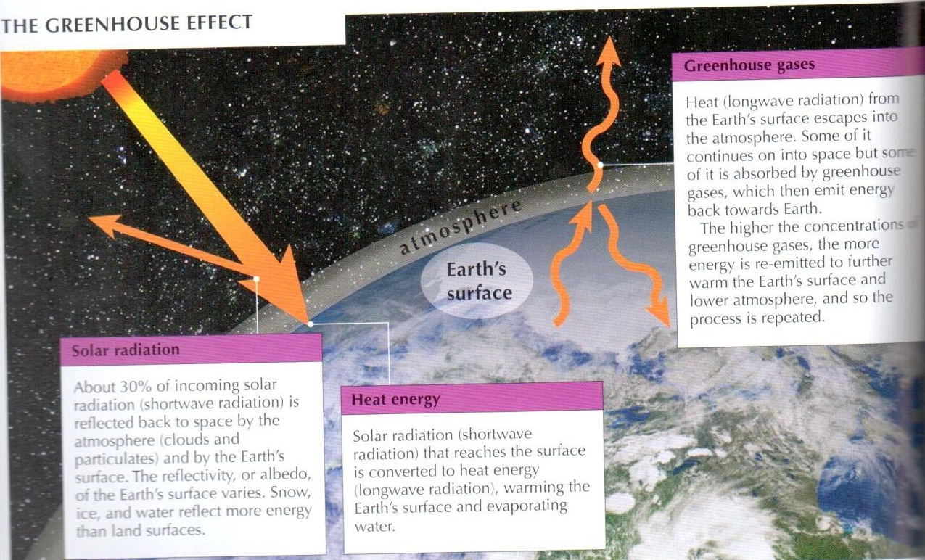

Slide 12
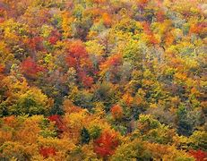
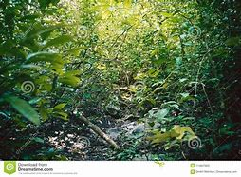
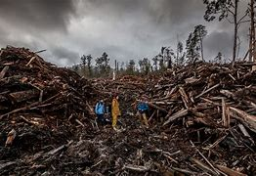
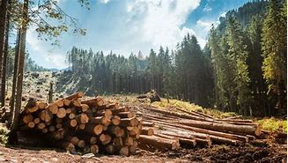
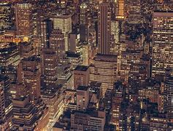
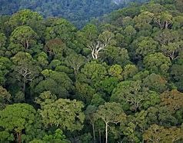

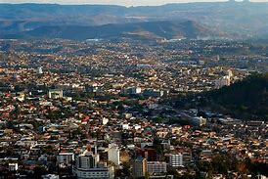
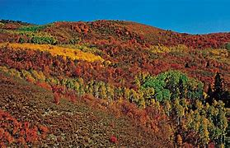

Slide 13
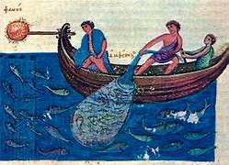
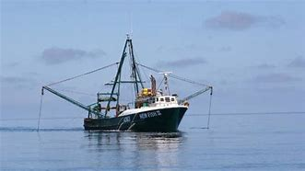
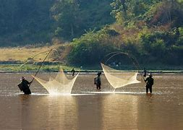
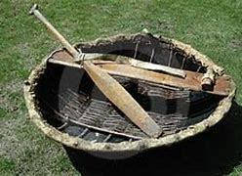
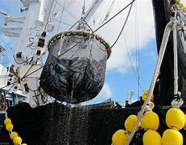
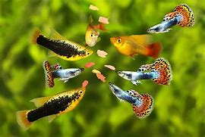
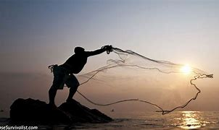
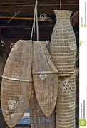
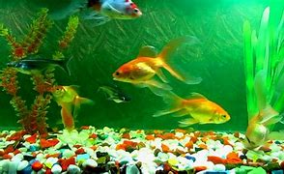

Slide 14
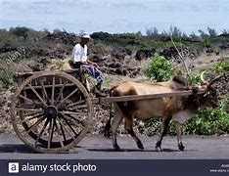
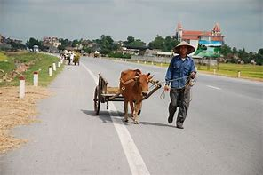
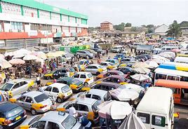
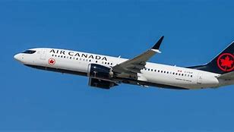
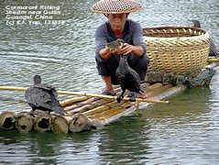
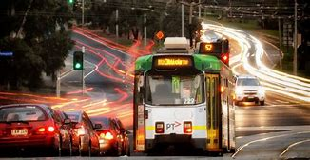
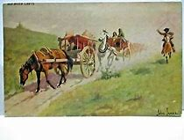
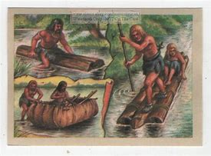
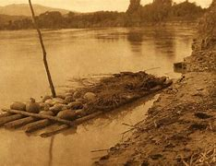
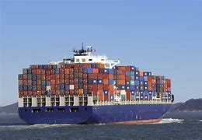
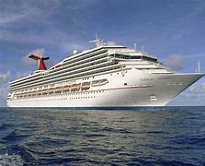

Slide 15
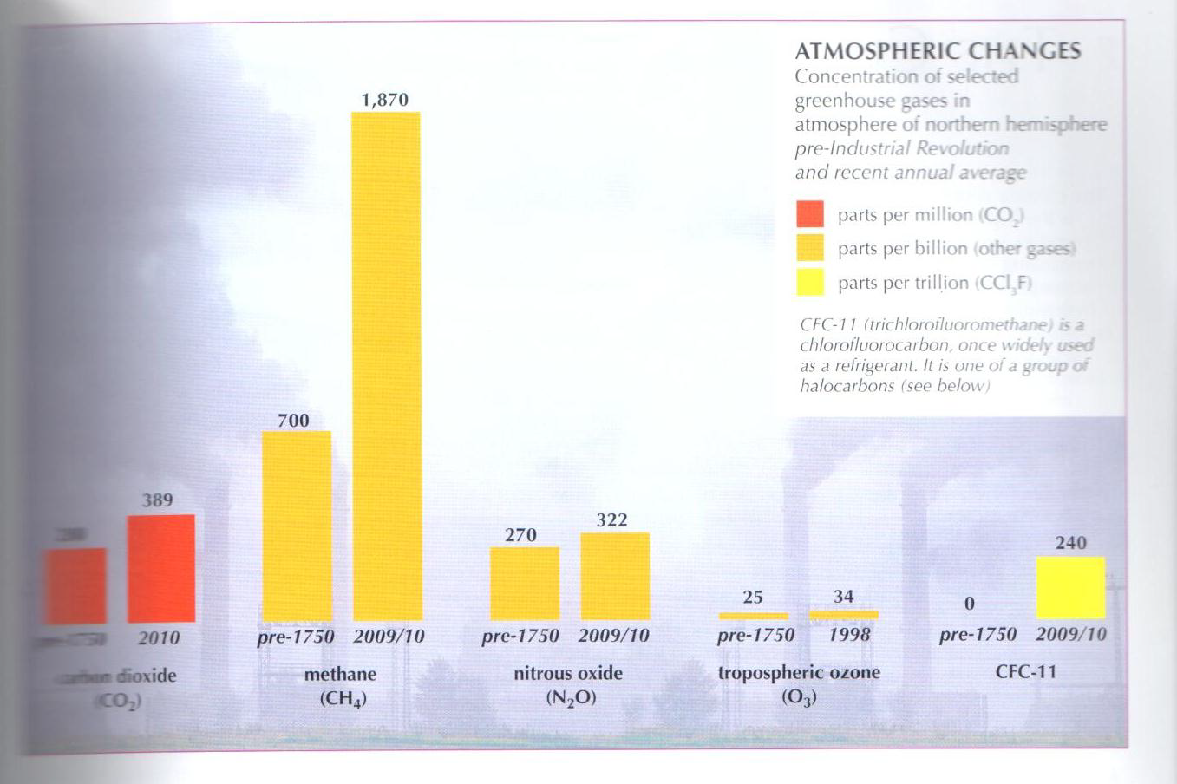

Slide 16
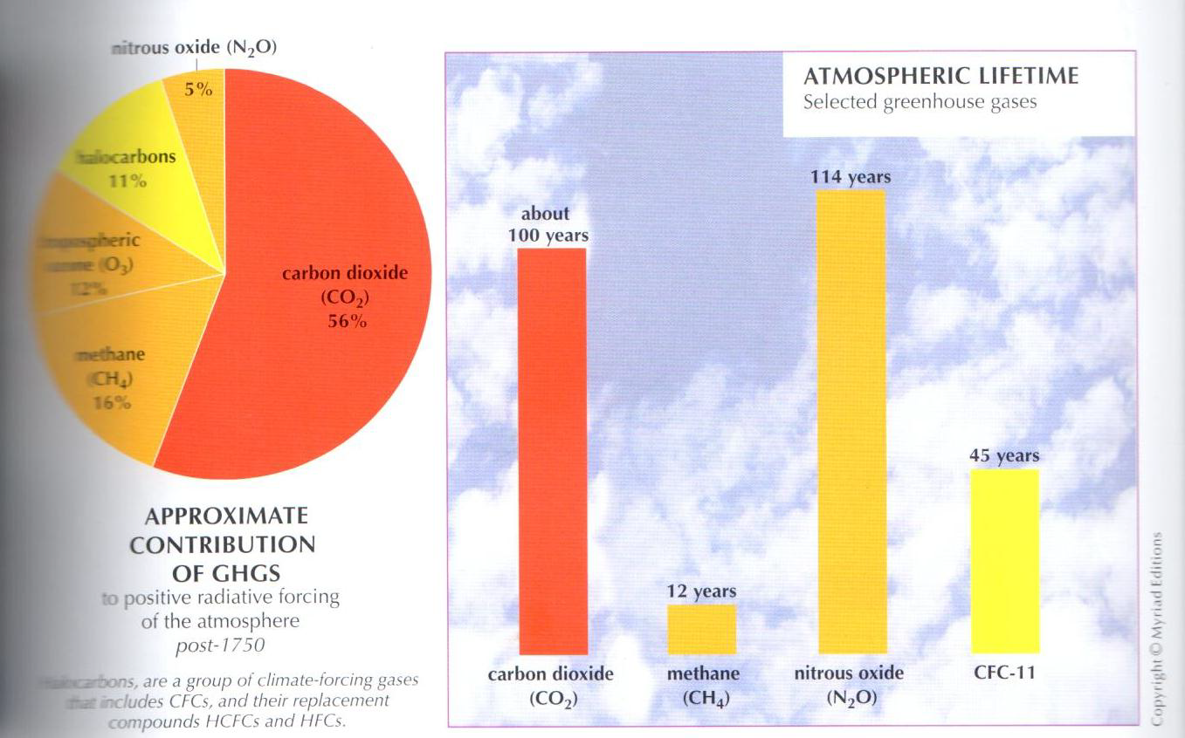

Slide 17
CAUSES

Slide 18
Burning of fossil fuels
for heating of homes and buildings
cooking
agriculture
manufacturing

Slide 19
Deforestation
Cutting down forests faster than they are replaced
Makes a huge contribution to CO₂
Agriculture and industries that replace the forests often cause problems
Pollution and soil erosion

Slide 20
World population
As world’s population grows, more people need food and energy
Fossil fuel CO₂ emissions continue to increase
Gasses are added too fast
Urgent actions

Slide 21
consequences

Slide 22
Ecosystem disruption:
General shifts of ecosystems towards the pole
Species & ecosystems already under stress from human
Catastrophic events can further disrupt ecosystems

Slide 23
Shifts in blooming date & time of reproduction & species distributions
Decline of Adelie penguin populations
Invasion by non-native species
Ability of birds to migrate limited by human population & cultivation
Huge area of Bay of Bengal, home to the Bengal tiger, is threatened by rising sea levels

Slide 24
Water scarcity:
Higher temperatures result in more evaporation from surface water
Warmer & longer summers > snow & glacier melt
Seasonal rains failing to materialize
Changes in river run-off

Slide 25
Food:
Climate change is threatening agriculture in many regions
But may benefit crop production in some regions

Slide 26
Health:
Exposure to weather-related disasters such as heat waves, cyclones, sea level rise, ocean acidification, altered growing seasons
Higher temperatures: heat stress, pollution, forest fires
Intense rainfall: diseases
Heavy rainfall: contamination

Slide 27
Rising sea level:
Inundation of Maldives islands, some islands in the Caribbean and Pacific
Lost of agricultural lands
Coastal cities threatened
Low-lying communities at risk from storm surges

Slide 28
Cities at risk:
Coastal storms, flooding, erosion, saltwater intrusion
Inundation of large delta areas

Slide 29
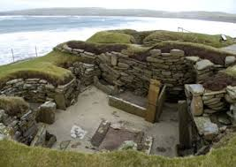
Erosion is damaging 12,000 sites in Scotland

Slide 30
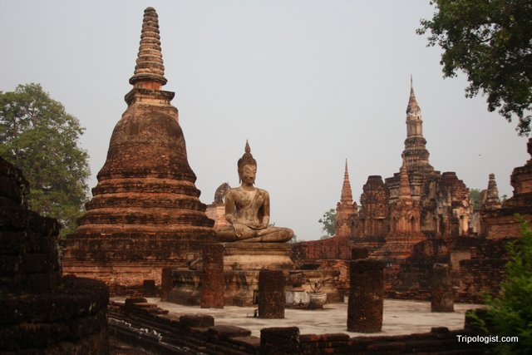
Severe flooding threatens historical sites such as Sukothai and Ayutthaya ruins in Thailand

Slide 31
RESPONSES
~ Responses of cities ~
London - reduce emissions by 60% by 2025 (1990 level)
Bangladesh - social protection, disaster management, infrastructure research
Tokyo - renewable energies & electric cars
Sydney - become C neutral by reducing C emissions from vehicles

Slide 32
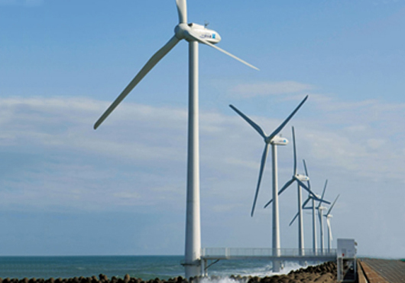
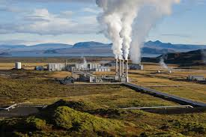
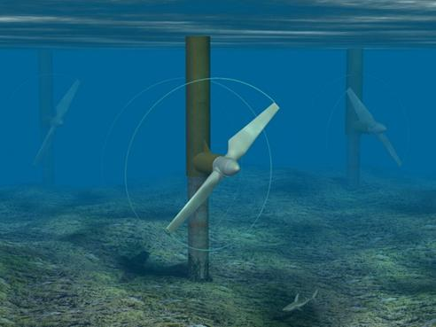
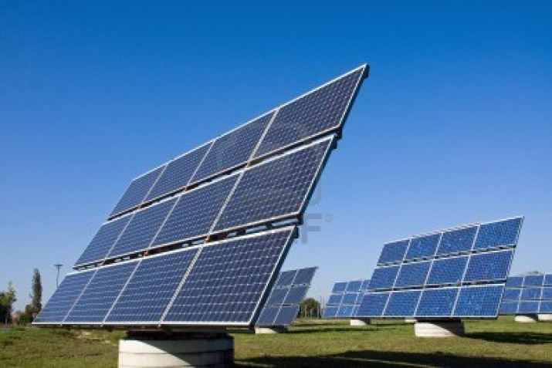
~ Renewable energy ~

Slide 33





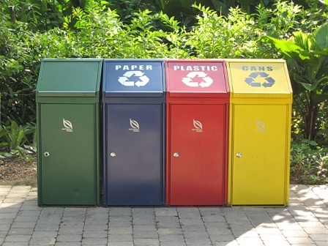


What can we do?

Slide 34
discussions
Causes of climate change | Consequences of climate change | Consequences of climate change

Slide 35
Discussions
In the face of global climate change, please explain how we should response as a ..
Individual/personal
Community (university)
Community (villages)
Government/country
International

Slide 36
Next:
Impacts of climate change and human activities on the ocean

Slide 37
Thank you!
See you all on next Thursday !

